Slide 1
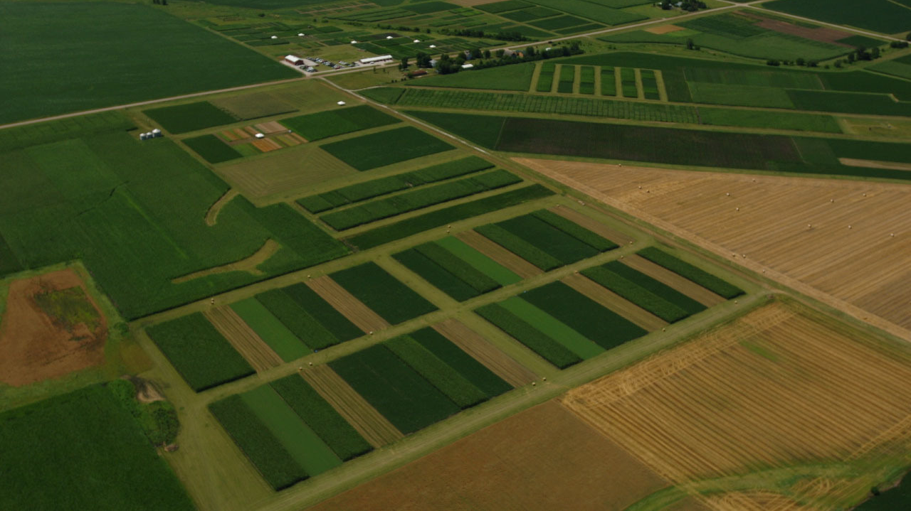
Weeds’ responses in simple versus diversified cropping systems
Huong Nguyen
April 15, 2022
Credit: Matt Liebman
Notes:
Long-term, large-scale experiment that houses weed management, soil health, plant pathology, entomology and crop physiology

Slide 2
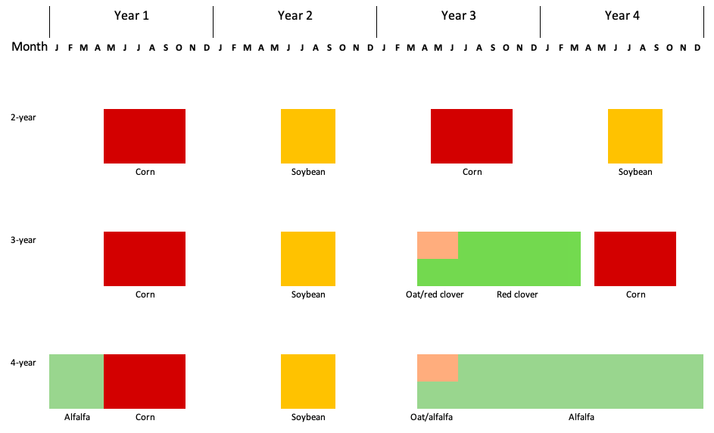


Rotation
Notes:
The design is RCBD, here is what happened in each block
No herbicide was applied in oat/red clover and alfalfa
Corn and soybean received 2 herbicide regimes up to 2016
From 2017, corn continued to receive 2 herbicide regimes, soybean 1
Arrows represent tillage timing and methods

Slide 3
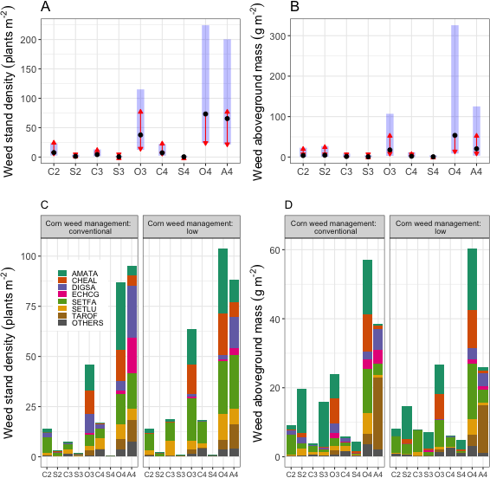
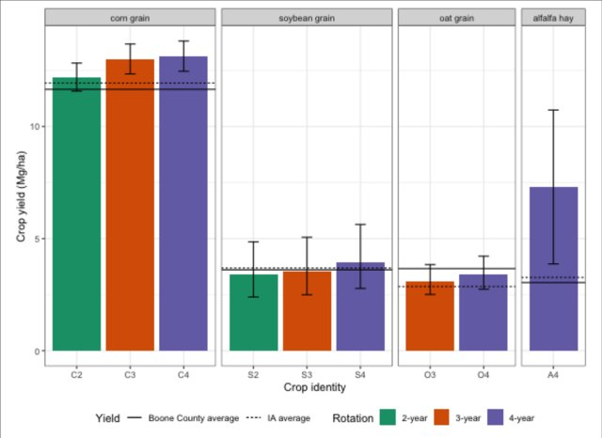
Weed aboveground community
Crop yields were comparable or higher than Iowa and Boone County averages.
Tolerating higher abundance of weeds can save a substantial amount of herbicide a.i.
Aggressive weed species’ abundance was lowered in the more diverse cropping systems.
Nguyen & Liebman. 2022. Front. Agron., doi:10.3389/fagro.2022.811359
Notes:
Question: How does cropping system diversification with cool-season crops change weed aboveground community?
Overall. 34 weed species were found, 20 dicots and 14 monocots
Higher weed abundance → higher diversity and richness indices and lower evenness index

Slide 4
Weed seedbank diversity as a potential sustainability indicator
Liebman et al., 2021. Weed Res. doi:10.1111/wre.12466
Credit: Natalie Hunt
Performance indicator | 4-year rotation | 2-year rotation | F | p | Data source
Maize grain yield (dry), Mg ha⁻¹ yr⁻¹ | 10.6 (0.19) | 10.2 (0.19) | 6.14 | 0.04 | Hunt et al., (2019)
Soyabean seed yield (dry), Mg ha⁻¹ yr⁻¹ | 3.4 (0.08) | 2.8 (0.09) | 28.28 | 0.0007 | Hunt et al., (2019)
Energy content of all harvested products, GJ ha⁻¹ yr⁻¹ | 120 (4.5) | 120 (3.0) | 0.00 | 1.00 | Hunt et al., (2020)
Net returns to land and management, $ ha⁻¹ yr⁻¹ | 872 (60.3) | 833 (71.6) | 0.33 | 0.58 | Hunt et al., (2019)
Herbicide aquatic toxicity, CTUe ha⁻¹ yr⁻¹ | 2,363 (532) | 4,727 (1,064) | 18.49 | 0.003 | Hunt et al., (2017)
Soil sediment loss, Mg ha⁻¹ yr⁻¹ | 1.0 (0.16) | 2.6 (0.48) | 3.65 | 0.007 | Hunt et al., (2019)
Total N discharge in run-off, kg ha⁻¹ yr⁻¹ | 6.2 (0.89) | 10.0 (1.80) | 6.63 | 0.03 | Hunt et al., (2019)
Total P discharge in run-off, kg ha⁻¹ yr⁻¹ | 1.6 (0.23) | 2.3 (0.45) | 5.68 | 0.04 | Hunt et al., (2019)
Nitrate-N discharge in leachate, kg ha⁻¹ yr⁻¹ | 15.4 (4.51) | 19.8 (6.95) | 1.06 | 0.33 | Hunt et al., (2019)
Fossil energy use, GJ ha⁻¹ yr⁻¹ | 3.4 (0.14) | 9.5 (0.35) | 119.23 | <0.0001 | Hunt et al., (2020)
GHG emissions, kg CO₂e ha⁻¹ yr⁻¹ | 281 (15.2) | 783 (31.3) | 96.56 | <0.0001 | Hunt et al., (2020)
PM_{2.5}-related human health damage, $ ha⁻¹ yr⁻¹ | 298 (11.6) | 688 (22.4) | 62.65 | <0.0001 | Hunt et al., (2020)
Notes:
Question: How does seedbank diversity in different cropping systems align with established cropping system performance indicator?
This project went beyond weed management by looking at resource use efficiency
Comparison of weed seedbank diversity, crop yield, and environmental footprints in 2-year vs. 4-year rotation. The 2-year rotation consists of corn and soybean, and the 4-year rotation is an extension of the 2-year with three cool-season crops planted over 2 year:
Similar to the Weed aboveground community project, higher diversity and species richness but lower evenness were observed in the more diverse rotation; crop yield at the experiment site was higher than Iowa and Boone County’s averages.
Draw the audience’s attention to the red and green lines

Slide 5
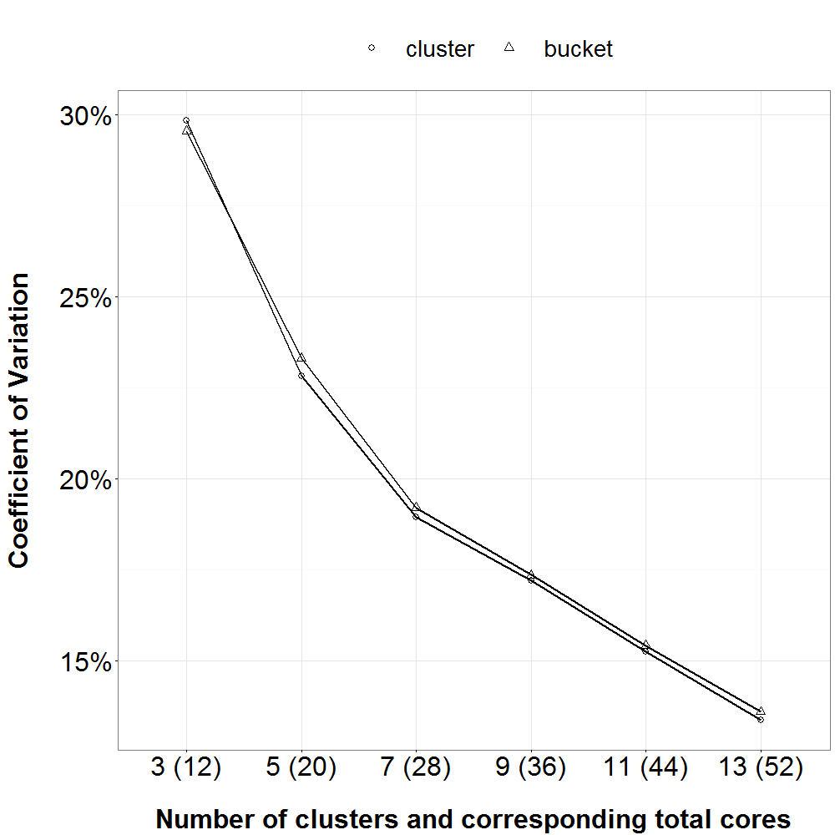
Soil sampling for seedbank density
X X X X | X X X X | X X X X
X X X X | X X X X | X X X X
X X X X | X X X X | X X X X
Nguyen 2016. ISU Theses and Dissertations.
doi: 10.31274/etd-180810-5407
Notes:
Questions:
How much soil sample should be taken to parsimoniously estimate the soil seedbank?
How can soil cores be processed?
Answer: 36 cores, 20 cm depth, distributed in a grid of 3x3 throughout each EU. Cores should be taken in cluters and can be combined into one data point.

Slide 6
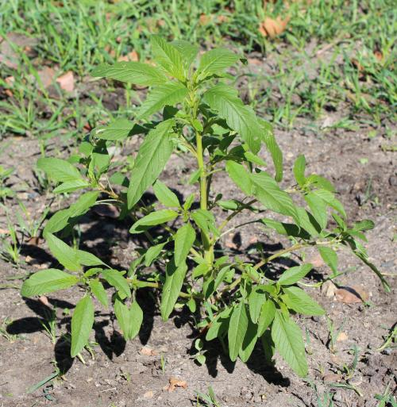
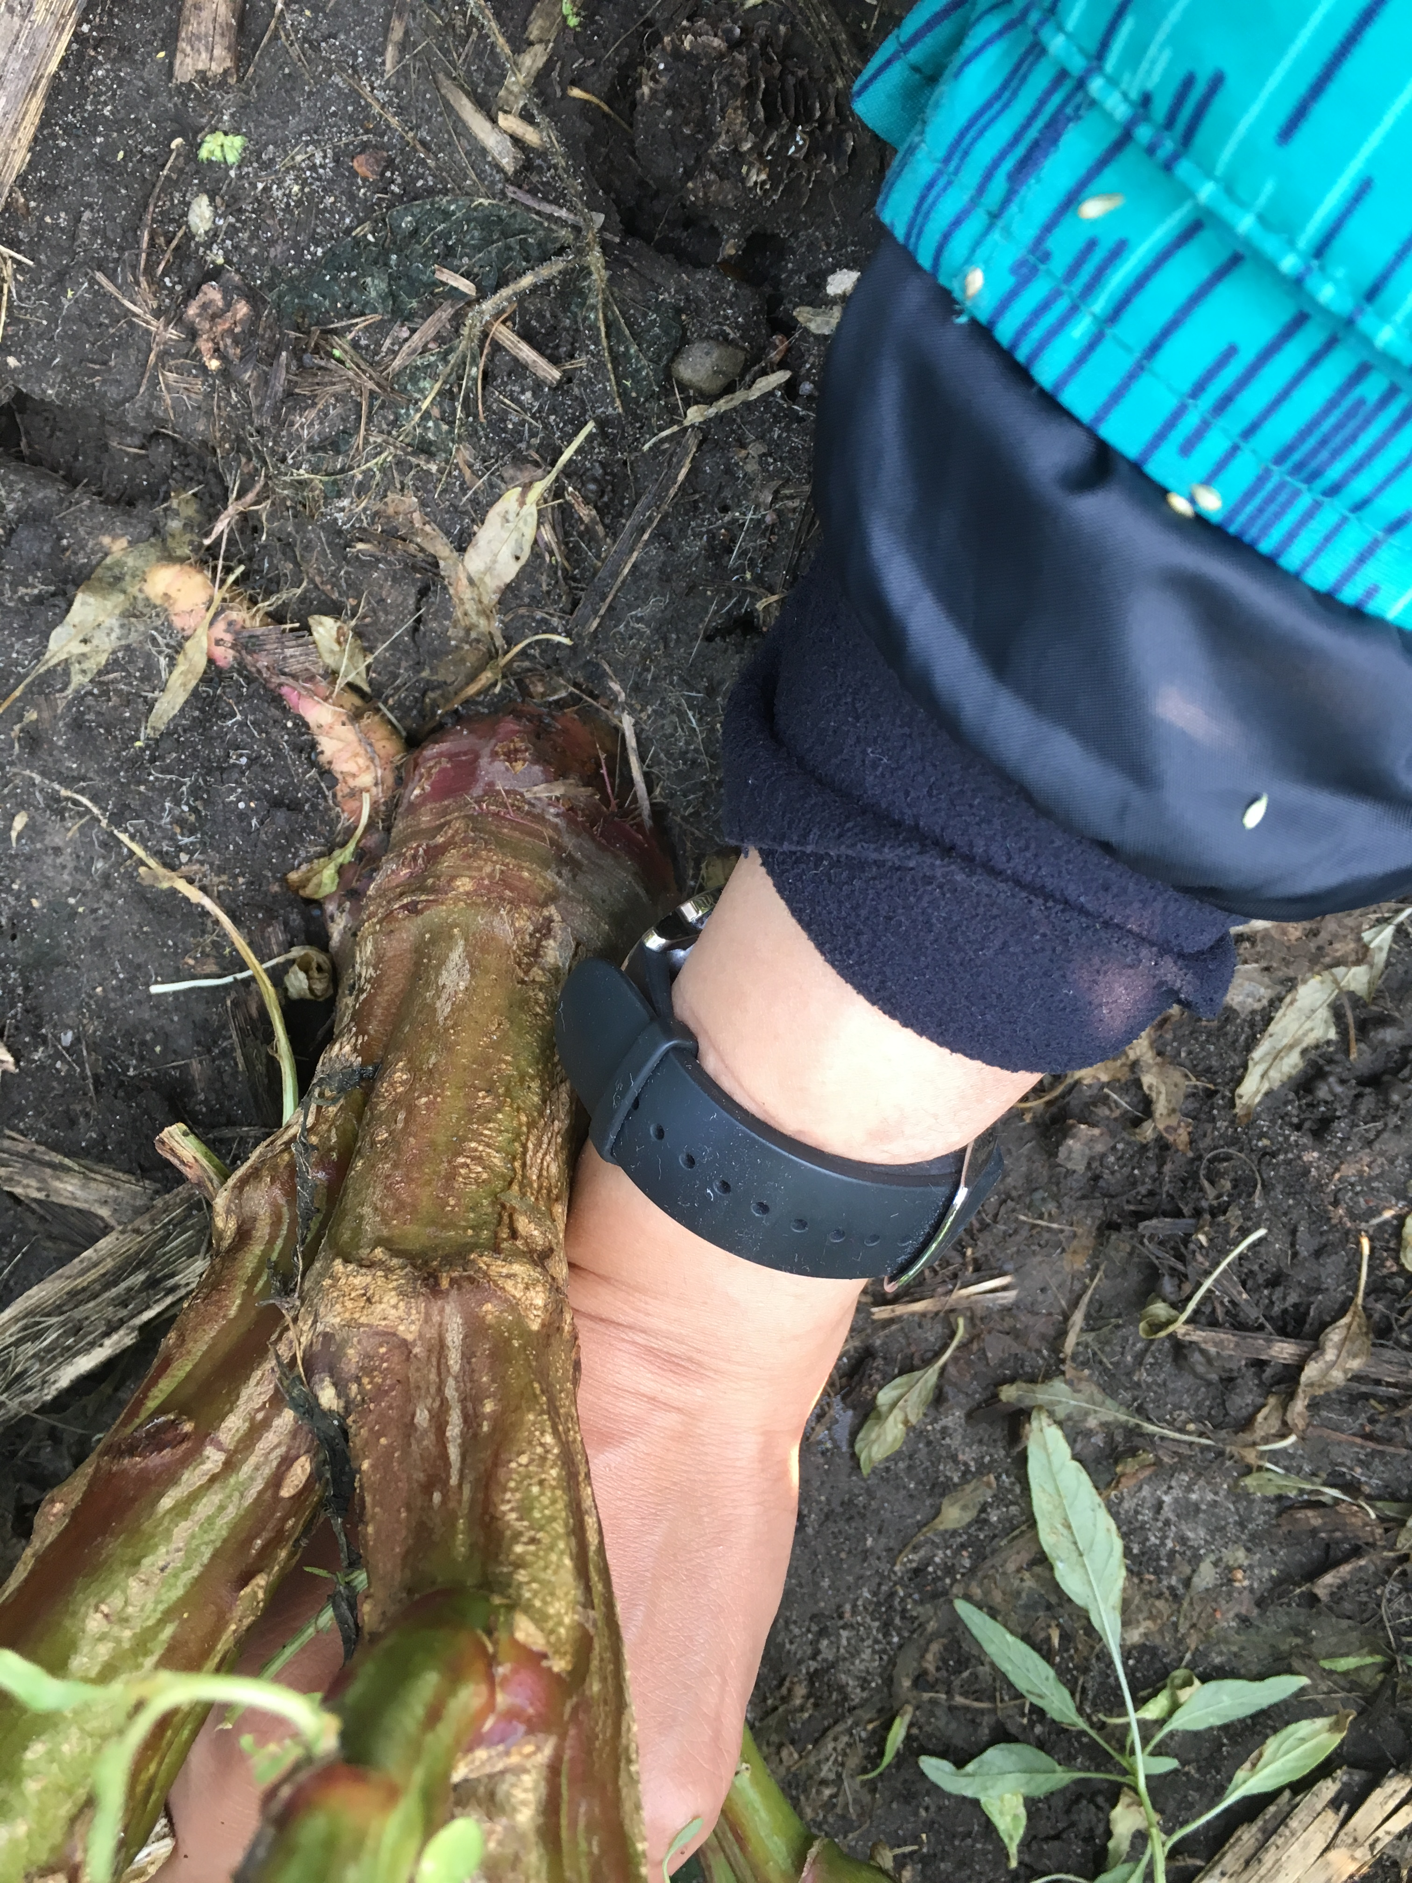
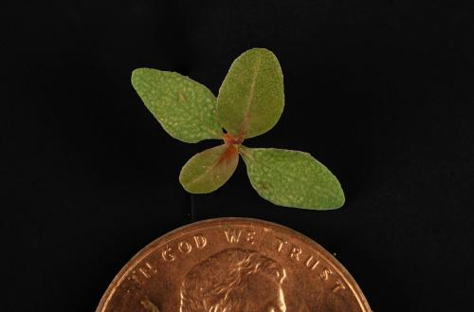
Waterhemp – an agronomically challenging weed species in row crops
Credit: Rebecca Vittetoe https://crops.extension.iastate.edu/encyclopedia/waterhemp
Credit: Huong Nguyen

Slide 7
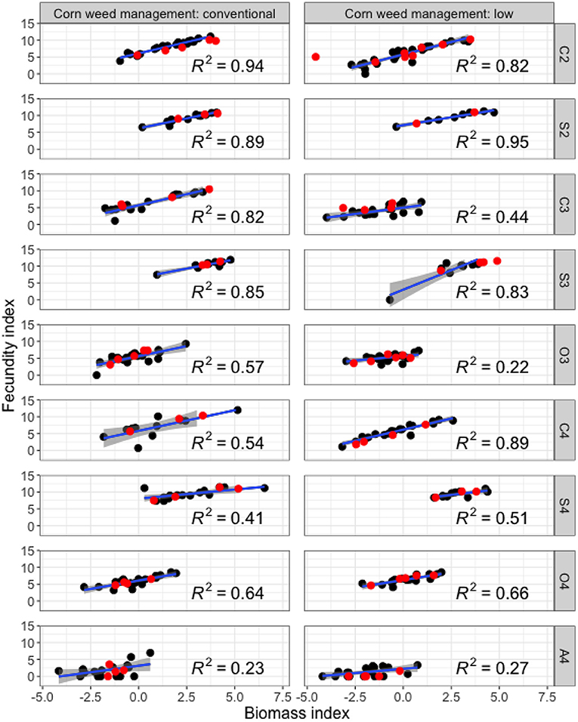
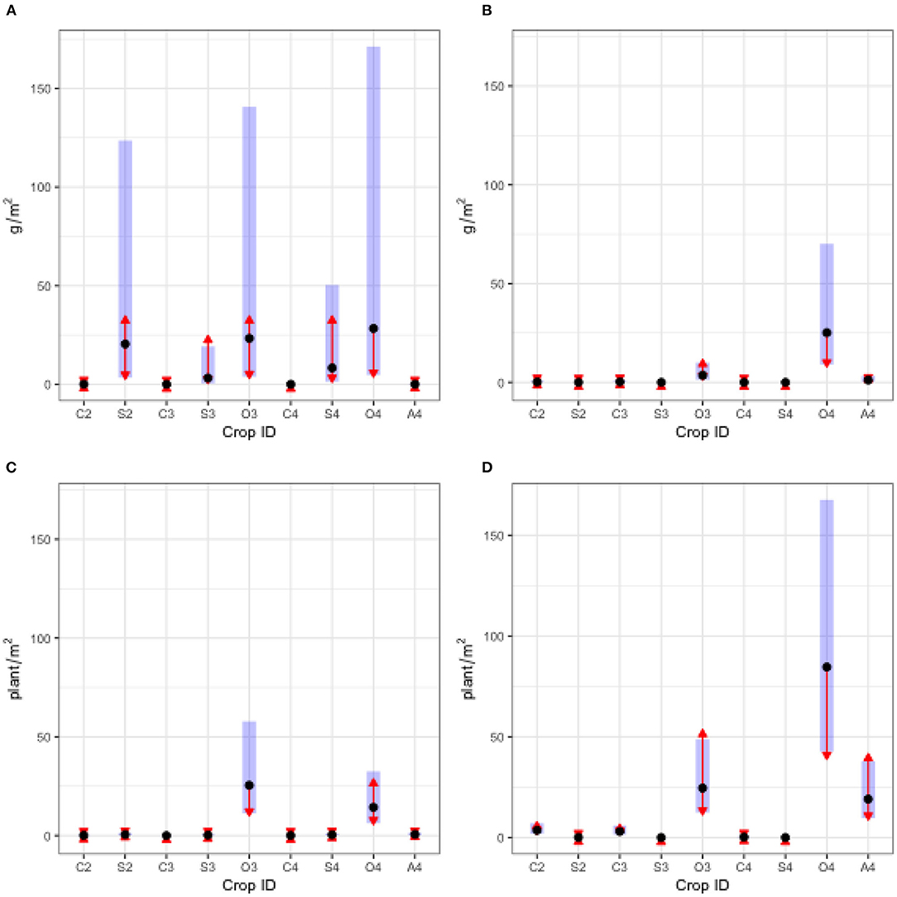
Waterhemp abundance and reproductive potential Nguyen & Liebman. 2022. Front. Agron., doi:10.3389/fagro.2022.848548
Notes:
Questions:
1 – How does waterhemp abundance change in different cropping systems?
2 – How can aboveground mass be used to parsimoniously estimate fecundity?
Left: weed abundance, by density and aboveground mass, 2018 and 2019
Right: Reproductive potential: 2018 data
Fecundity index = ln(seed + 1)
Biomass index = ln(biomass + 0.005)

Slide 8
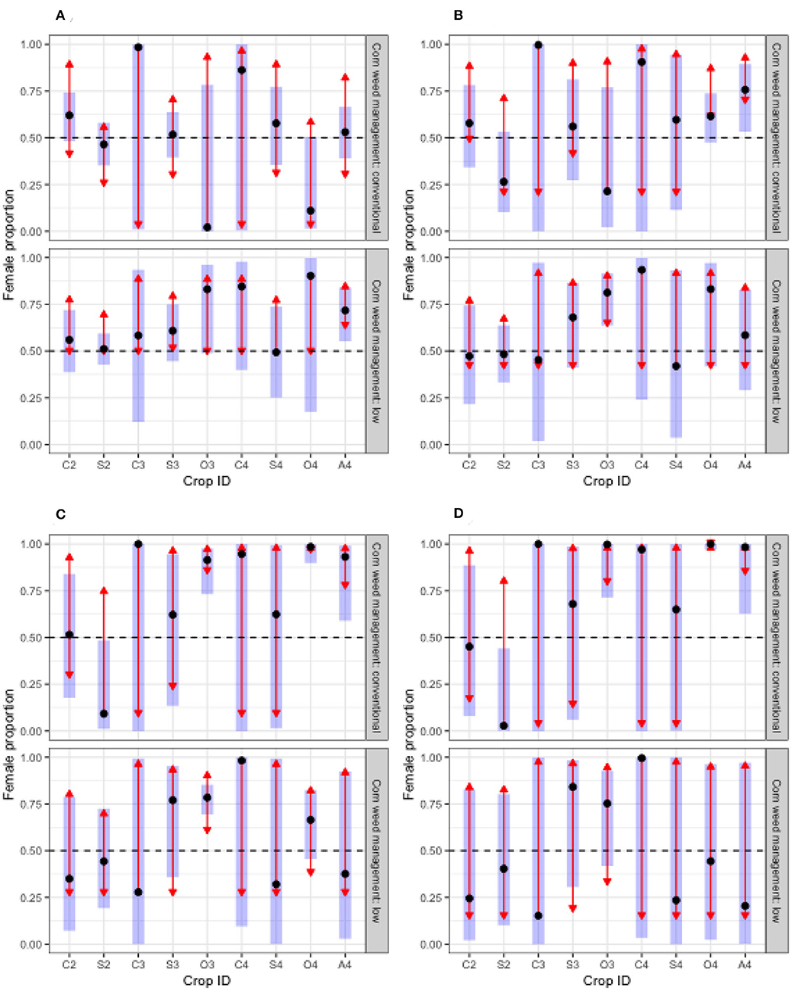
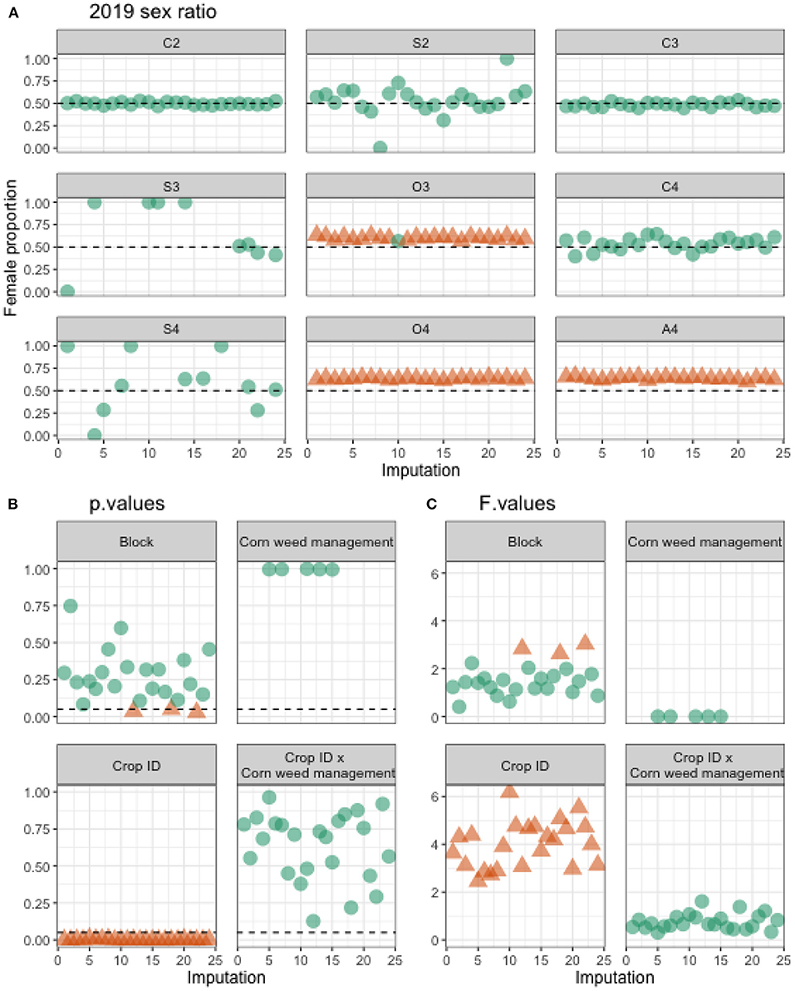
2018 sex ratio
Notes:
Question: Does population sex ratio changes between cropping systems?
Left: 2018 sex ratio with original data
Right: 2019 sex ratio with imputed data. 2019 herbicide efficacy was very high.

Slide 9
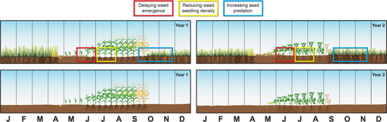
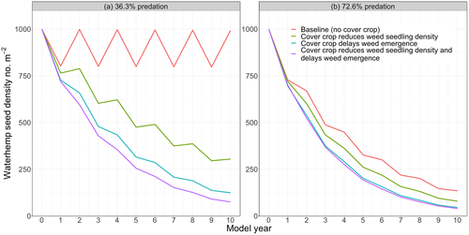
Contribution of rye cover crop in controlling waterhemp
Credit: Lana Koepke Johnson
Scenario | Required herbicide efficacy
 | 36.3% seed predation | 72.6% seed predation
No-cover crop | ≥99.955% | ≥99.896%
Cover crop reduces seedling density | ≥99.929% | ≥99.834%
Cover crop delays seedling emergence | ≥99.891% | ≥99.745%
Cover crop reduces seedling density and delays seedling emergence | ≥99.826% | ≥99.595%
Liebman et al.,2021. Weed Res. doi:10.1111/wre.12508
Notes:
Question: How does rye cover crop contribute to waterhemp control?
A STELLA model examined 4 scenarios with a baseline cropping system of corn and soybean.
Parameters were taken from the literature
Conditions: no tillage, add-allow (waterhemp plants are allowed to deposit seeds to the soil surface at the end of amodel year)
Answer: above 99% herbicide efficacy is needed to keep waterhemp soil seedbank in check in all scenarios. At 72.6% seed predation, seedbank can decline rather quickly within the first 3 model years, and would be 86% lowered by the end of the 10th model year.

